Slide 1
TOPIC 9.6
NITROGEN & SULPHUR

Slide 2
NITROGEN
In Group V
Electronic configuration :
exists as a diatomic molecule N₂
makes up 79% of atmospheric gases
very unreactive
REASON :

Slide 3
AMMONIA
Hydride of nitrogen (covalent bond)
higher than expected boiling point
REASON :
Shape : trigonal pyramidal
REASON :

Slide 4
AMMONIUM ION & AMMONIUM SALTS
Formation of ammonium ion :
Ammonia use its lone pair to form a dative bond to a proton
Formation of ammonium salts :
formed when ammonium reacts with acids
e.g NH₃ + HCl → NH₄Cl
Displacement of ammonia :
Ammonia is displaced from its salts by treating them with a stronger base
e.g NaOH + NH₄Cl → NH₃ + NaCl + H₂O

Slide 5
HABER PROCESS
N₂(g) + 3H₂(g) 2NH₃(g) △H = -92 kJ mol⁻¹
Condition : - Pressure
- Temperature
- Catalyst

Slide 6
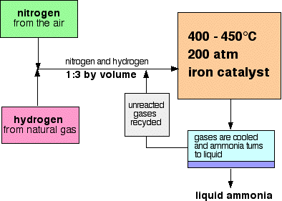
HABER PROCESS

Slide 7
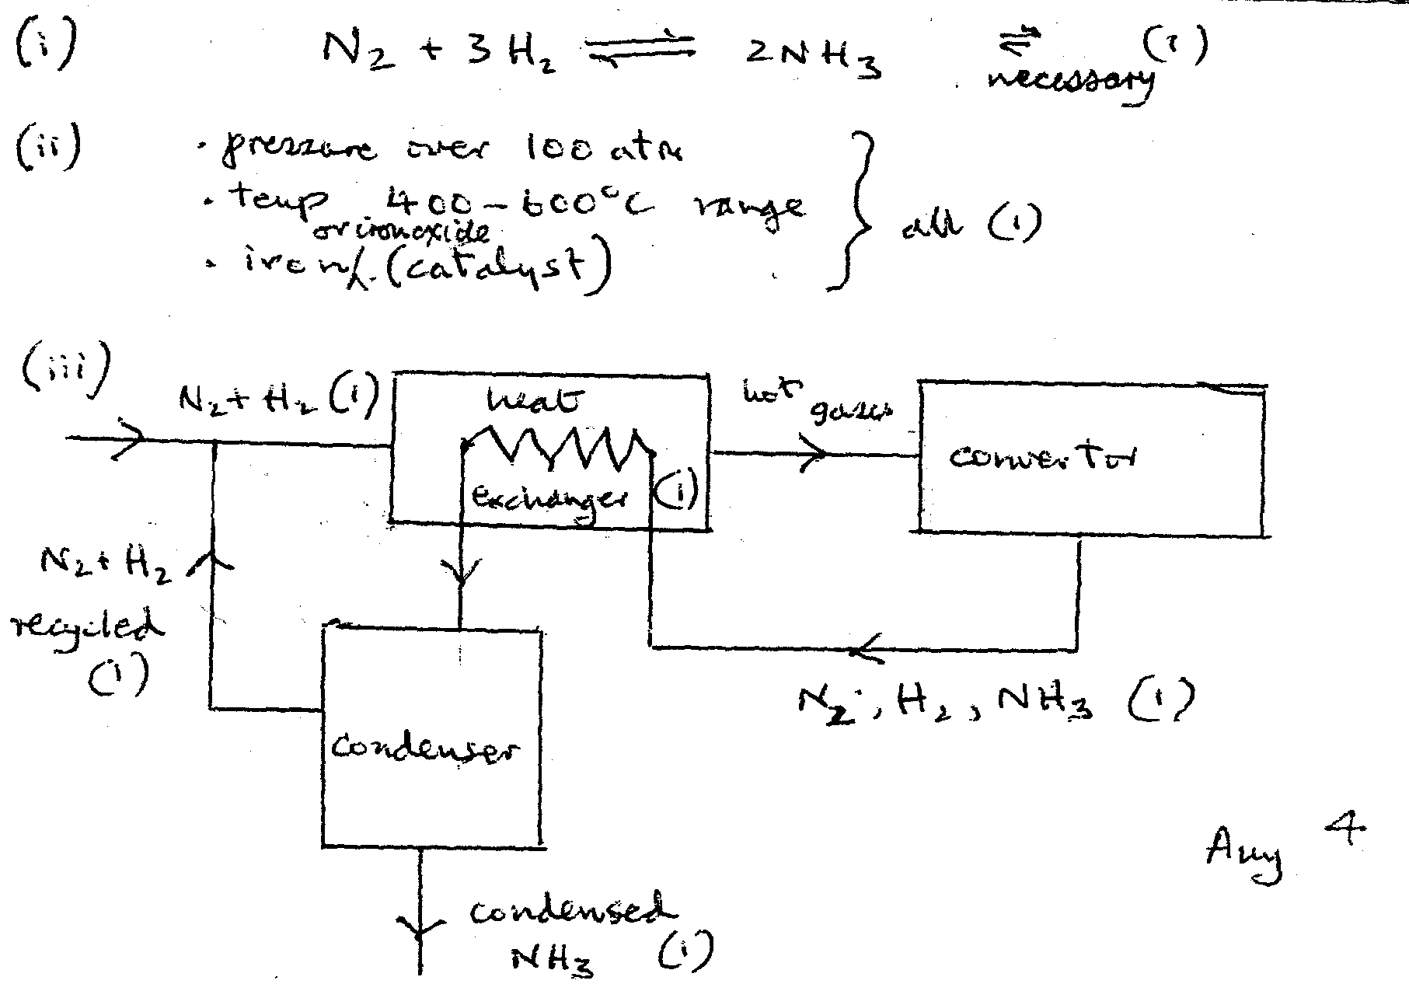

NOV 02 Paper 2

Slide 8
USE OF AMMONIA
production of nitrogenous fertilisers.
manufacture of nitric acid
manufacture of explosives
manufacture of nylon
as a cleaning agent
as a refrigerant

Slide 9
ENVIRONMENTAL PROBLEMS
uncontrolled use of nitrogenous fertilisers
- Eutrophication
~ when excessive amounts of nitrogenous fertilisers get into lakes and streams causes excessive growth of aquatic plants/algae. When plants and algae die O₂ is used up/fish or aquatic life die.
- effect on drinking water
~ Blue baby syndrome
NO_{x} pollution
- acid rain
- NO₂ catalyses oxidation of SO₂

Slide 10
CATALYTIC CONVETERS
Two pollutants that may be formed in an internal combustion engine are carbon monoxide,CO, and nitrogen monoxide, NO.
CO by incomplete combustion of the hydrocarbon fuel
NO by reaction between N₂ and O₂ in the engine
main hazard associated with each of these pollutants.
CO toxic/ bind with haemoglobin to reduce O₂ carrying capacity
NO toxic / formation of acid rain
Pollutants such as CO and NO are removed from the exhaust gases of internal combustion engines by catalytic converters which are placed in the exhaust system of a car.

Slide 11
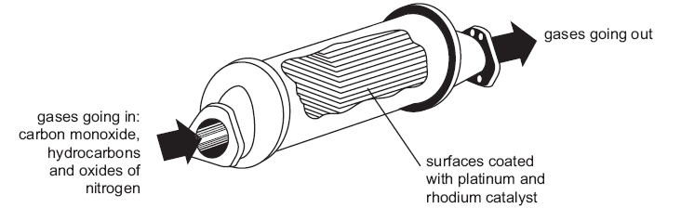
CATALYTIC CONVETERS

Slide 12
CATALYTIC CONVETERS
to remove oxides of nitrogen, NO_{x} from exhaust gases
three catalysts (platinium, palladium, rhodium) are coated on a ceramic honeycomb structure
three catalyst are selective in the reactions they promote
Rh 2NO(g) + 2CO(g) → 2CO₂(g) + N₂(g)
Pt/Pd 2CO(g) + O₂(g) → 2CO₂(g)
C_{x}H_{y}(g) + (x + y/4)O₂(g) → xCO₂(g) + y/2H₂O(g)
lead poisons / deactivates the catalysts
(car must be run on unleaded petrol)

Slide 13
ACID RAIN
Fossil fuels contain sulphur and its compounds which burn to produce SO₂
S + O₂ → SO₂
SO₂ dissolves in water to produce sulphurous acid (weak acid)
SO₂ + H₂O 2H⁺ + SO₃²⁻
Nitrogen oxides catalyses the oxidation of SO₂ to SO₃
SO₂ + NO₂ → SO₃ + NO
NO + ½O₂ → NO₂
-------------------------------------------------------
overall SO₂ + ½O₂ → SO₃
SO₃ dissolves in water to produce sulphuric acid (strong acid)
SO₃ + H₂O → 2H⁺ + SO₄²⁻

Slide 14
EFFECT OF ACID RAIN
Erosion of rocks
Damage to stone buildings
Increasing acidity in rivers and lakes
De-forestation

Slide 15
CONTACT PROCESS
  3 steps :
(1) S(s) + O₂(g) → SO₂(g)
(2) 2SO₂(g) + O₂(g) 2SO₃(g) △H = -197 kJ mol⁻¹
(3) SO₃ + H₂O → H₂SO₄
~ SO₃(g) + H₂SO₄(aq) H₂S₂O₇(aq)
H₂S₂O₇(aq) + H₂O(l) 2H₂SO₄(aq)

Slide 16
USES OF SULPHURIC ACID
Making fertilisers
Making detergents
Making explosive
lead/acid batteries
Making paints
Dyestuffs

Slide 17
EFFECTS OF SULPHUR DIOXIDE
GOOD
- reducing agent
- Food preservative
- Contact process
BAD
- pollutant
- major sources of acid rain
- causes breathing disorders

